Slide 1

AGV
VS
AMR
Understand The Difference
Syed Ahmad Alsagoff
1816833

Slide 2
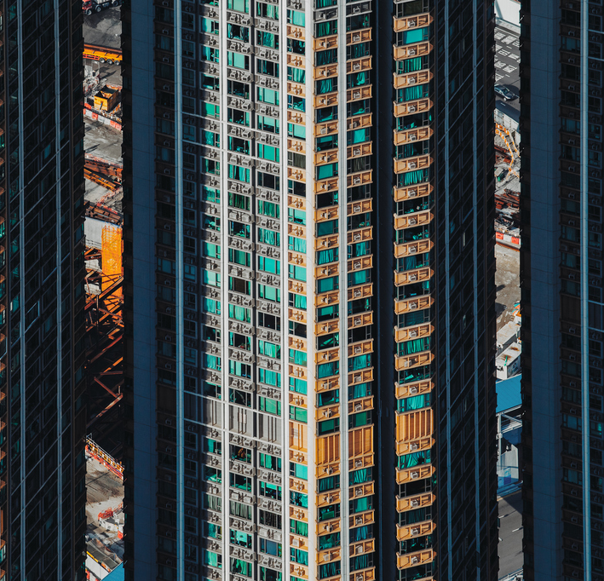
Agenda
Automated vs Autonomous
Path Planning
Flexibility & Versatility
Scalability
Redeployability
Intelligence
Usability

Slide 3

Automated vs
Autonomous
Let’s dive in

Slide 4
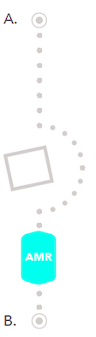

Automated
Autonomous
Computer-controlled
Performs a pre-defined set of tasks or follows a pre-defined path
The specific path is pre-defined by humans before
Controlled by Artificial Intelligence to make decisions when faced with obstacles
Able to learn as they encounter new situations

Slide 5

Path Planning
How to get from Point A to Point B

Slide 6
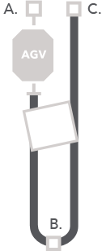
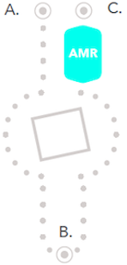
AGV
AMR
Operation occurs without direct driver input or pre-configured scripts to control the steering, acceleration, and braking
Utilizes laser-based perception and navigation algorithms to dynamically navigate the environment
Machine learning capabilities enable the robot to become more efficient and accurate as it encounters new situations.
Rely on guidance devices such as magnetic tape, beacons, barcodes or predefined laser paths
Lasers and sensors detect obstacles in its path and trigger the vehicle to stop automatically

Slide 7
Flexibility
&
Versatility
Reaction to different applications

Slide 8
Flexibility & Versatility
Fixed
Follows a predefines path using lasers, beacons or magnetic tape
Multiple AGV units are required for different applications.
Ongoing infrastructure maintenance is required.
Minor debris in the laser’s field of view prevents the vehicle from moving until obstacle is manually removed by human personnel.
Implementation is easy and highly scalable due to the lack of external infrastructure for navigation
1 AMR unit can be used for multiple applications
Parameters can be customized to navigate through aisleways, personnel zones, and narrow corridors.
Human interaction is not required during navigation
AGV
AMR

Slide 9
Redeployability

Slide 10
Redeployability
Setup time is minimal and can be completed by the customer with a centrally controlled fleet manager
Units can be shared and utilized among multiple facilities
AMRs can become a shared resource; therefore, less units are required for purchase.
AMR
Equivalent to installing an AGV system for the first time
Changes are rigid and costly
Multiple systems are required in total
AGV

Slide 11
Scalability
Let’s dive in

Slide 12
Scalability
Additional AMRs can be deployed in less than a day as they operate from a centrally controlled map, shared among the fleet.
Infrastructure renovations, facility planning, or additional training are not required.
AMR customers do not need to outsource work to 3rd party vendors for changes or additional implementation.
AGV
Can be added to facility if layout adheres to AGV infrastructure requirements.
Resources are required for facility planning, infrastructure innovations, maintenance and line training.
Facility layout must be designed to accommodate equipment.
AMR

Slide 13
Intelligence
Let’s dive in

Slide 14
Intelligence
Intelligence is not required
Lack of data collection leads to lack of insight in to real-time KPIs or vehicle performance
Standard stack lights and sounds are unchanging, despite changes in environment.
AGVs are unable to back up or take alternate routes.
AGVs cannot easily integrate with other solutions.
Onboard intelligence
Machine learning collects data and updates the fleet’s shared map with learned parameters.
AMRs learn which routes are the fastest and take optimal paths, even within unpredictable environments.
Plant personnel can safely and collaboratively interact with AMRs.
AGV
AMR

Slide 15
Usability

Slide 16
Usability
AGVs are designed to do simple tasks, yet setup and operation is cumbersome, complex, and costly.
AGVs require trained expertise by certified personnel or engineers.
Changes to the system require facility infrastructure updates and additional staff training.
Implementation includes mapping facility
System is set up by the customer and is done so with a point and click interface.
Updates to robot or access zones can be made by plant personnel.
Changes in production lines or distribution layouts are easily implemented.
AGV
AMR

Slide 17

Conclusion
AMRs are a much more flexible robots to be utilized however the simplicity of an AGV leads to less computational power and a much reduced cost.
We can conclude that AGVs are the best cost effective options for simple repetitive tasks whereas AMRs are more suitable for complex tasks that involve other robots or human involvement

